Slide 1


PowerPoint Presentation
Group: - Humanities.
Social Science.
Topic: - Democracy in the Contemporary World

Slide 2
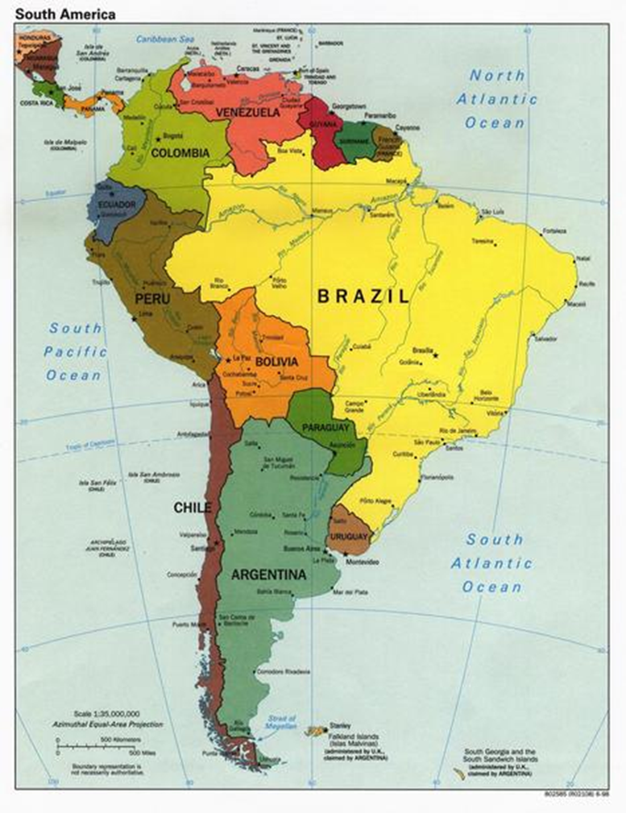
Location Of Chile
It is a country located in South America occupying a long, narrow strip of land .
The shape of Chile is distinctive ribbon of land 4,300 kilometers long
In regards to the geographical northernmost and southernmost points of Chile, it is the longest country in the world, and includes the 5th lengthiest coastline at over 78 thousand kilometers.
It’s capital in Santiago.

Slide 3
Dictatorship
Democracy
A Government for the people, by the people and to the people and the rule of the Majority.
A country, government or the form of government in which absolute power is exercised by a dictator.

Slide 4
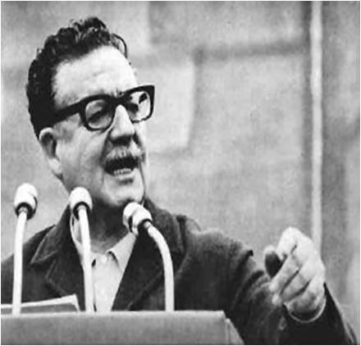
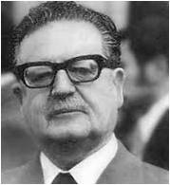
Salvador Allende
Salvador Allende was the President of Chile, country in South America.
He was the founder of the Socialist Party of Chile who won the Presidential election in 1970.
Though his rule was overthrown by the military just after three years on 11 September 1973.

Slide 5
Allende’s Rule
Allende after being elected as the President took several decisions to help the poor and the workers. These included -:
Reform of educational system.
Free milk for children.
Redistribution of land to the landless labours.
He also opposed foreign companies from taking natural resources from the country.

Slide 6
The People who disliked Allende.
Allende was liked by the poor people and the workers but the rich landlords, the church people and other political parties opposed his government.
They didn’t like Allende’s policy of spending too much on the workers.
On 26 May 1973, Chile’s Supreme Court, which was opposed to Allende's government, unanimously denounced the Allende disruption of the legality of the nation. Although illegal under the Chilean constitution, the court supported and strengthened Pinochet's seizure of power.

Slide 7
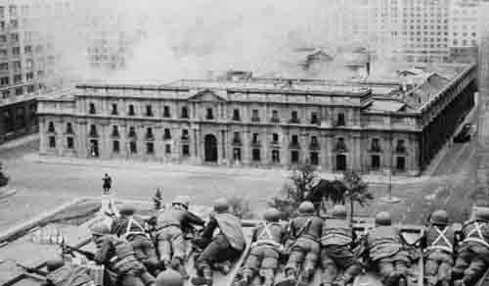
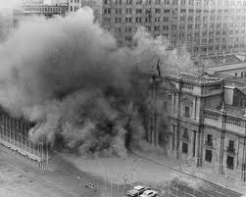
Death of Allende
On the morning of 11th September 1973, the military took over the seaport, The Defense minister was arrested by the military when he arrived at his office.
The military commanders asked the President to resign.
Allende refused to resign or leave the country.
But realizing the danger to the country and to his life, he addressed the people on the radio.
Then the military surrounded the president’s house and started bombing it.

Slide 8
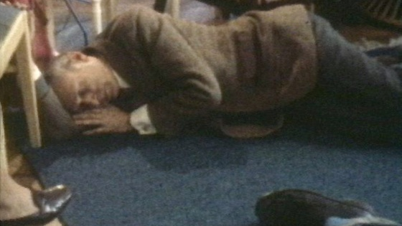
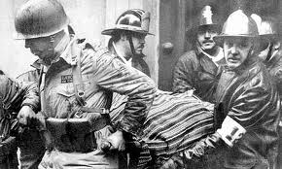
President Allende died in the military attack. This was the sacrifice he was talking about in his last speech.
A government and people elected was overthrown by the military through conspiracy and violence.
What took place in this story is a military coup. General Augusto Pinochet army general, led the coup.
The government of U.S.A was unhappy with the rule of Allende and have known to support the coup destroying Allende.

Slide 9
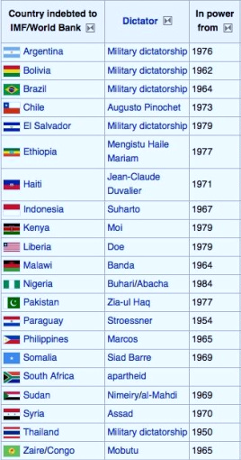
Military coup of 1973
Finally on the morning of 11 September 1973, the military led by General Augusto Pinochet took over the seaport, arrested the Defence Minister from his office.
The military commanders asked the President to resign and Allende refused the military surrounded the President’s house and started bombing it.
Allende died in the military attack.
A military coup occurred in Chile and a government elected by people was overthrown by violence and conspiracy.
After this military General Augusto Pinochet, who led the coup became the President of Chile and ruled for 17 years.

Slide 10
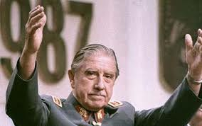
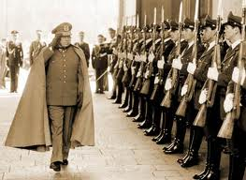
11th September 1973
General Augusto Pinochet was a the army officer and led the military coup.
On this day Pinochet became the president of Chile and ruled it for the next 17 years as a dictator.

Slide 11
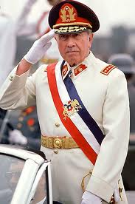
Pinochet became the President of the country and ruled for the next 17 years.
From a government that was elected by the people, the power shifted to the military officers.
They could do as they wished and no one could question them.
Thus a military dictatorship was established in Chile.
Pinochet’s government was tortured and killed several of those who supported Allende and those who wanted democracy to be restored.

Slide 12
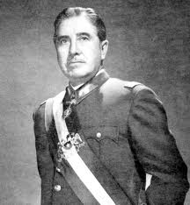
These included General Alberto Bachelet of Chilean Air Force and many other officers who refused to join the coup.
General Bachelet’s wife and daughter were put in prison and tortured.
More than 3,000 people were killed by the military.
Many more were reported ‘missing’. No one knows what happen with them.

Slide 13
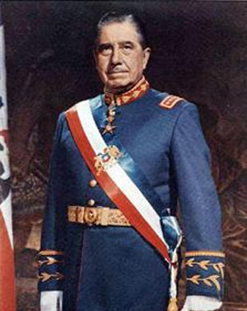
Restoring of Democracy -1998
Pinochet’s military dictator ship came to an end after he decided to hold a referendum 1988.
He felt confident that in this referendum, the people would say ‘yes’ to his continuing in power. But the people of Chile has not forgotten their democratic traditions.
Their vote was decisive ‘no’ to Pinochet.
This led to Pinochet losing first his political and then his military powers.

Slide 14
The hope Allende expressed in his last address was realized: felony, cowardice and treason were finally punished.
Political freedom was restored.
Since then Chile had held 4 presidential elections in which different political parties have participated.
The elected governments that came to power ordered inquires into Pinochet’s rule.
These inquires showed that his government was not only very brutal, but also very corrupt.

Slide 15
Political election held in 1989 & after
Patricio Aylwin won a sweeping victory in the first democratic elections, in December 1989,in Chile.
A presidential election was held in Chile on December 11, 1993. Eduardo Frei Ruiz- Tagle, son of former president Eduardo Frei Montalva, won the election by absolute majority.
Lagos was sworn in March 11, 2000, for a 6-year term as the president of Chile.
In 2006 Michelle Bachelet, became the first president pf Chile by beating Sebastian Piñera in the election.

Slide 16
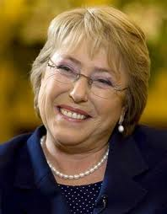
Story Of Michelle Bachelet

Slide 17
Michelle Bachelet daughter of general Bachelet who was imprisoned and tortured along with her mother was elected president of Chile in January 2006.
A medical doctor and a moderate socialist , Michelle became the first women to be a defence minister in Latin America.
In the presidential elections none Chile’s richest men.

Slide 18
Democracy in Poland
This event in Poland happened in 1980.
At that time Poland was ruled by Polish United Worker’s Party.
This was one of many communist parties that ruled in several countries of east Europe at that time.
In these countries no other political party was allowed to function.
The people could not freely choose the leaders of the communist party or the government.

Slide 19
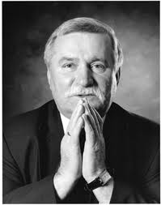
Those who spoke against the leader’s, party or government they were put in prison.
The government in Poland was supported and controlled by the government of (USSR), a vast and powerful communist state.
On 14 August 1980, the workers of Lenin Shipyard in the city o Gdansk went on a strike. The shipyard as owned by the government.
The strike began with a demand to take back a crane operator, a woman worker, who was unjustly dismissed from service.
This strike was illegal, because trade unions independent of the ruling party were not allowed in Poland.

Slide 20
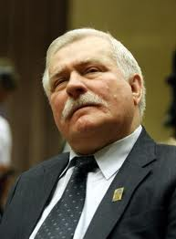
As the strike continued a former electrician of the shipyard, Lech Walesa, joined the strikers.
He was dismissed from service in 1976 for demanding higher pay.
Walesa soon emerged as the leader of striking workers.
The strike began to spread across the whole city.
Now the worker started raising larger demands. They wanted the right to form independent trade unions.
They also demanded the release of political prisoners and end to censorship on press.

Slide 21
The movement became so popular that the government had to give in.
The workers led by Walesa signed a 21-point agreement with the government that ended their strike.
The government agreed to recognize the worker’s right to form independent trade unions and their right to strike.
After the Gdansk agreement was signed, a new trade union called Solidarity (Solidarnosc in polish) was formed.
It was the first time an independent trade union was formed in any of the communist states.
Within a year, Solidarity swept across Poland and had about one crore members.

Slide 22
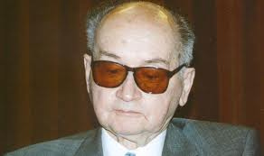
Jaruzelski
Revelations of widespread and mismanagement in the government made matters worse for the rulers.
The government led by General Jaruzelski grew anxious and imposed martial law in December 1981.
Thousands of Solidarity members were put in prison. Freedom to organize, protest and express opinions was once again taken away.
Another wave of strike, again organized by solidarity, began in 1988.
This time the Polish government was weaker, the support from Soviet Union uncertain and economy was in decline.

Slide 23
Phases in the expansion of democracy
The story of modern democracy began at least two centuries ago. French revolution of 1789. This popular uprising did not established a secure & stable democracy in France, throughout the 19th century. French revolution inspired many struggles for democracy all over Europe. In Britain , the progress towards democracy started much before the French revolution . But the progress was very slow. Through the 18th & 19th centuries, series of political events reduced the power of monarchy & feudal lords.

Slide 24
The right to vote was increased in the countries
British colonies in north America declared themselves independent in 1776.
In the next few years these colonies came together to form the United States of America.
America adopted a democratic constitution in 1787. But here too the right to vote was limited to very few men.
Major demand of people was the right for every adult citizen to vote.
In some countries only people owning property had the right to vote. Which was not correct.
Often women did not have a chance to vote.

Slide 25
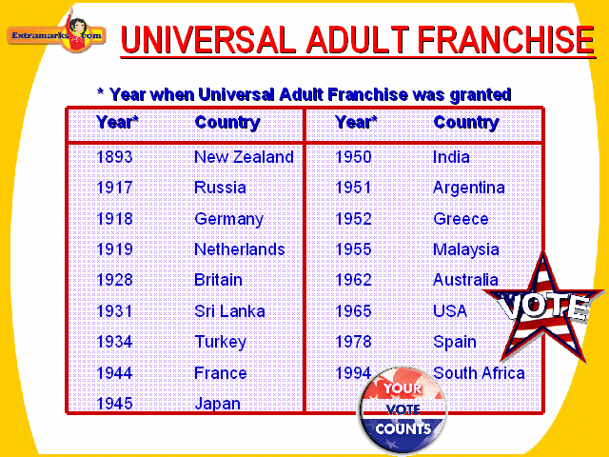
Universal Adult Franchise
In United states of America, the blacks all over the country could not exercise the right to vote until 1965.
Those struggling for democracy wanted this right granted universally to all adults-men or women, rich or poor, black or white

Slide 26
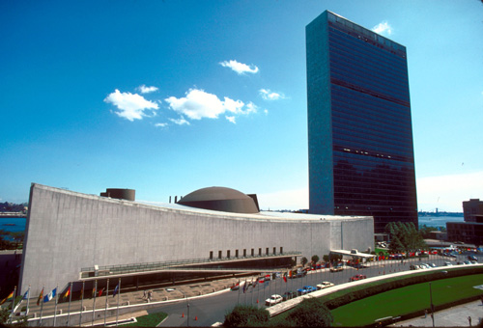
United Nations Organization
The United Nations is a global associated of nations of the world to help cooperation in international law, security, economic development & social equity. The UN secretary general is the chief administrative officer.
What happens when a country attacks another country in an unjust manner? The UN security Council, an organ of the UN, is responsible for maintaining peace & security among countries. It can put together an international army & take action against the wrongdoer.

Slide 27
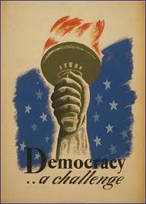
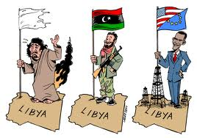
Democracy Promotion
Recently, many powerful countries in the world, particularly the US, have taken on the task of democracy promotion in the rest of the world.
They say that propagating the values of democracy is not enough. Existing democracies should directly intervene in countries that are non- democratic to establish democracy there.

Slide 28


